Slide 1

Apex Institute of Technology
Department of Computer Science & Engineering
Computer Networks
(CST-335)
Dr.Monica Luthra
E9836
Assistant Professor
CSE(AIT), CU
DISCOVER . LEARN . EMPOWER

Slide 2

Course Objectives
CO Number | Title
CO1 | Describe the important networking concepts
CO2 | Understand concept of network reference models and protocols
CO3 | Apply the concepts of routing algorithms on various networks
CO4 | Identify mechanism to handle traffic and control on congestion
CO5 | Identify and understand connection establishment techniques and features

Slide 3

Course Outcomes
After this course student will be able to:
To bring together several key of Computer network design and architecture
To Familiarize the student with the basic taxonomy and terminology of the computer networking area.
To Allow the student to gain expertise in some specific areas of networking such as the design and maintenance of individual networks.

Slide 4
Contents to be Covered
Network Layer Design Issues
Functions of Network Layer
IPv4 Addressing

Slide 5
Network Layer Design Issues
Store − and − Forward Packet Switching
Services to Transport Layer
Providing Connection Oriented Service
Providing Connectionless Service

Slide 6
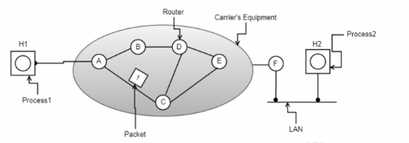
1. Store-and-Forward Packet Switching
Store-and-Forward Packet Switching
Here, the foremost elements are the carrier’s equipment (the connection between routers through transmission lines) and the customer’s equipment.
Image Source : https://www.elprocus.com/network-layer-types-and-design-issues/

Slide 7
2. Services Provided to the Transport Layer
Through the network/transport layer interface, the network layer delivers its services to the transport layer. One might come across the question of what type of services does the network layer provides?
So, we shall move with the same query and find out the services offered.
Services offered by the network layer are outlined considering few objectives. Those are:
Offering services must not depend on router technology
The transport layer needs to be protected from type, number and the topology of the available routers.
Network addressing the transport layer needs to follow a consistent numbering scenario also at LAN and WAN connections.

Slide 8
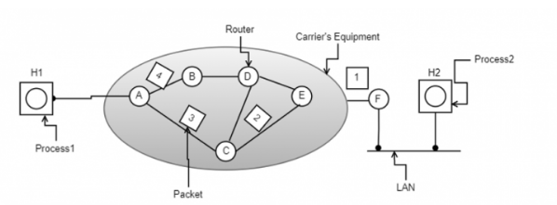
3. Implementation of Connectionless Service
In this scenario, packets are termed as datagrams and the corresponding subnet is termed as datagram subnet. Routing in datagram subnet is as follows:
Image Source : https://www.elprocus.com/network-layer-types-and-design-issues/

Slide 9
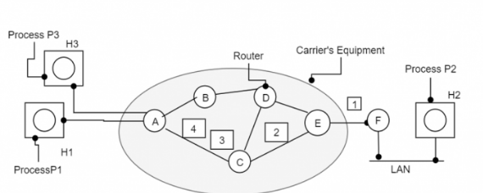
4. Implementation of Connection-Oriented Service
A virtual subnet performs the operation of avoiding a new path for each packet transmission. As a substitute for this, when there forms a connection, a route from a source node to a destination node is selected and maintained in tables. This route performs its action at the time of traffic congestion.
At the time when the connection is released, the virtual subnet also gets dismissed. In this service, every packet carries its own identifier that states the exact address of the virtual circuit. The below diagram shows the routing algorithm in the virtual subnet.
Image Source : https://www.elprocus.com/network-layer-types-and-design-issues/

Slide 10
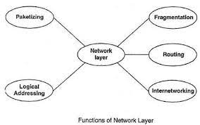
Functions of Network Layer
Host to host delivery(source to destination)
Logical (IP) addressing[ip address=net id,host id].
Routing-RIP(Distance,link state),OSPF. {Routers,switches}
Fragmentation
Congestion control(mostly used in transport layer to handle)[icmp,igmp,leaky bucket moethod,token bucket method]

Slide 11
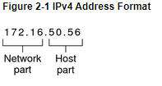
IPv4 - Addressing
Each IPv4-based network must have the following:
A unique network number that is assigned by either an ISP, an IR, or, for older networks, registered by the IANA. If you plan to use private addresses, the network numbers you devise must be unique within your organization.
Unique IPv4 addresses for the interfaces of every system on the network.
A network mask.
The IPv4 address is a 32-bit number that uniquely identifies a network interface on a system, as explained in How IP Addresses Apply to Network Interfaces. An IPv4 address is written in decimal digits, divided into four 8-bit fields that are separated by periods. Each 8-bit field represents a byte of the IPv4 address. This form of representing the bytes of an IPv4 address is often referred to as the dotted-decimal format.
The following figure shows the component parts of an IPv4 address, 172.16.50.56.
Image Source : https://docs.oracle.com/cd/E23823_01/html/816-4554/ipplan-5.html

Slide 12
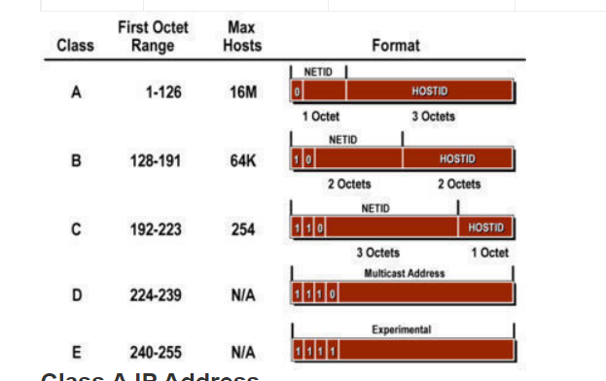
172.16
Registered IPv4 network number. In class-based IPv4 notation, this number also defines the IP network class, Class B in this example, that would have been registered by the IANA.
50.56
Host part of the IPv4 address. The host part uniquely identifies an interface on a system on a network. Note that for each interface on a local network, the network part of the address is the same, but the host part must be different.

Slide 13
Classful addressing
Introduced in 1981, with classful routing, IP v4 addresses were divided into 5 classes(A to E).
Classes A-C: unicast addresses
Class D: multicast addresses
Class E: reserved for future use
Class A
In a class A address, the first bit of the first octet is always ‘0’. Thus, class A addresses range from 0.0.0.0 to 127.255.255.255(as 01111111 in binary converts to 127 in decimal). The first 8 bits or the first octet denote the network portion and the rest 24 bits or the 3 octets belong to the host portion.
Example: 10.1.1.1

Slide 14
Class B
In a class B address, the first octet would always start with ’10’. Thus, class B addresses range from 128.0.0.0 to 191.255.255.255. The first 16 bits or the first two octets denote the network portion and the remaining 16 bits or two octets belong to the host portion.Example: 172.16.1.1
Class C
In a class C address, the first octet would always start with ‘110’. Thus, class C addresses range from 192.0.0.0 to 223.255.255.255. The first 24 bits or the first three octets denote the network portion and the rest 8 bits or the remaining one octet belong to the host portion.
Example: 192.168.1.1

Slide 15
Class D
Class D is used for multicast addressing and in a class D address the first octet would always start with ‘1110’. Thus, class D addresses range from 224.0.0.0 to 239.255.255.255.
Example: 239.2.2.2 Class D addresses are used by routing protocols like OSPF, RIP, etc.
Class E
Class E addresses are reserved for research purposes and future use. The first octet in a class E address starts with ‘1111’. Thus, class E addresses range from 240.0.0.0 to 255.255.255.255.

Slide 16
Classless Inter-Domain Routing (CIDR)
CIDR or Class Inter-Domain Routing was introduced in 1993 to replace classfull addressing. It allows the user to use VLSM or Variable Length Subnet Masks.
CIDR notation:
In CIDR subnet masks are denoted by /X. For example a subnet of 255.255.255.0 would be denoted by /24. To work a subnet mask in CIDR, we have to first convert each octet into its respective binary value. For example, if the subnet is of 255.255.255.0. then :

Slide 17
First Octet:
255 has 8 binary 1's when converted to binary
Second Octet:
255 has 8 binary 1's when converted to binary
Third Octet:
255 has 8 binary 1's when converted to binary
Fourth Octet:
0 has 0 binary 1's when converted to binary

Slide 18
Classless addressing concerns the following three rules when assigning a block.
Rule 1 – All the IP addresses in the CIDR block must be contiguous.
Rule 2 – The block size should be presentable as a power of 2. Moreover, the number of IP addresses in the block is equivalent to the size.
Rule 3 – First IP address of the block must be dividable by the block size.
For example, assume that the classless address is 192.168.1.35/27
The number of bits for the network portion is 27, and the number of bits for the host is 5. (32-27)
Representing the address in binary is as follows.
11000000. 10101000. 00000001. 00100011

Slide 19
The highlighted bits represent the host bits.
First IP address – 11000000.10101000.00000001.00100000 (assigns 0 to all host bits)
192.168.1.32
Last IP address – 11000000.10101000.00000001.00111111 (assigns 1 to all host bits)
192.168.1.63

Slide 20
Difference Between Classful and Classless Addressing
Classful addressing is an IP address allocation method that allocates IP addresses according to five major classes. Classless addressing is an IP address allocation method that is designed to replace classful addressing to minimize the rapid exhaustion of IP addresses.
Usefulness
Another difference between classful and classless addressing is their usefulness. Classless addressing is more practical and useful than classful addressing.
Network ID and Host ID
In classful addressing, the network ID and host ID changes depending on the classes. However, in classless addressing, there is no boundary on network ID and host ID. Hence, this is another difference between classful and classless addressing.

Slide 21

Key Points
Classful addressing categorizes the IP addresses into five major classes: class A, B, C, D, and E.
Classless addressing is also called Classless Inter-Domain Routing (CIDR). This addressing type helps to allocate IP addresses more efficiently. When the user requires a particular number of IP addresses, this method assigns a block of IP addresses concerning certain rules.
A unique network number that is assigned by either an ISP, an IR, or, for older networks, registered by the IANA. If you plan to use private addresses, the network numbers you devise must be unique within your organization.

Slide 22
Thank you
Please Send Your Queries on:
e-Mail: monica.e9836@cumail.in

